Slide 1
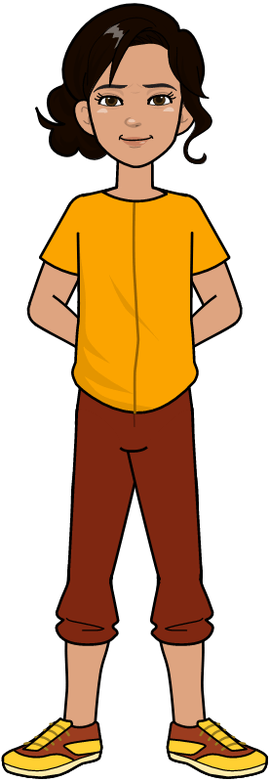
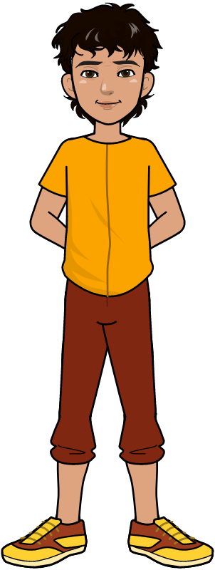
Introduction to Python Programming

Slide 2
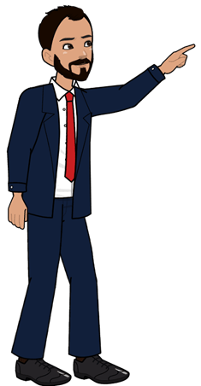
Learning Objectives
Students shall be able to define variables and their use in programming.
Students shall learn the use of arithmetic operators.
Students shall learn the use of print function.
Students shall learn the use of strings.
Students shall learn how to get the input from the user.
Computer Science Department, UET Lahore.

Slide 3
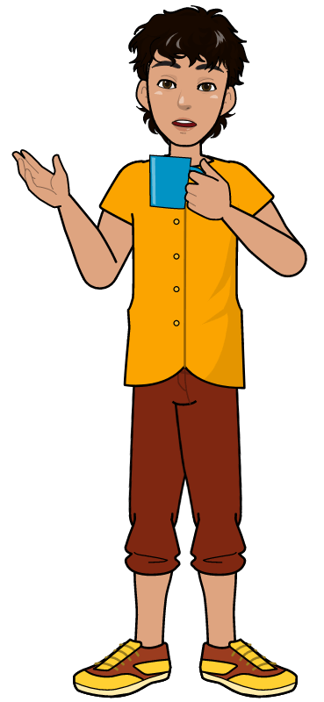
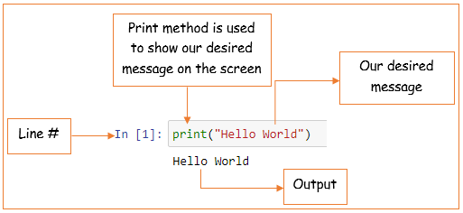
First python program!
Let’s write our first python program.
Computer Science Department, UET Lahore.

Slide 4
What if we want to take input from user?
To take input from user we need a container
to store the value entered by the user.
This container is called a variable.
Everyone of us has used variables in mathematics.
e.g. x=10 where ‘x’ is the variable and 10 is the value which will be stored in ‘x’.
Computer Science Department, UET Lahore.

Slide 5
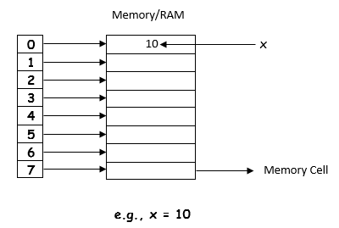
How does a variable works in computer?
Variable ‘x’ represents a memory cell in RAM and the value ’10’ is stored in that memory cell.
Computer Science Department, UET Lahore.

Slide 6
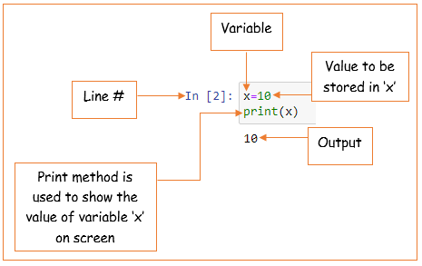
Variable example
Computer Science Department, UET Lahore.

Slide 7
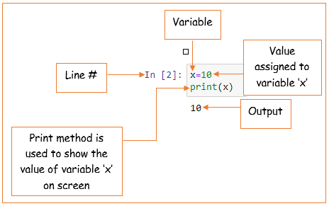
Assignment statement in python
Computer Science Department, UET Lahore.

Slide 8
Taking input from user
Lets modify the “Hello World” program and replace the “World” with user’s name.
To take input from the user we use input method of python.
Computer Science Department, UET Lahore.

Slide 9
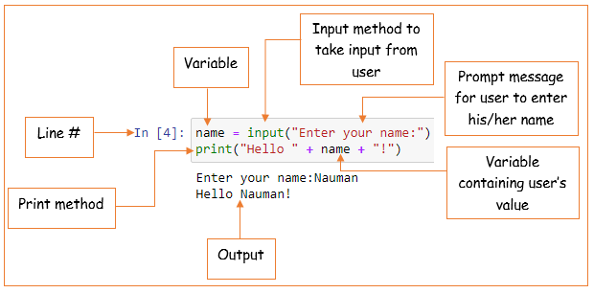
Taking input from user (example)
Computer Science Department, UET Lahore.

Slide 10
Naming variables in python
A variable can have a short name (like x and y) or a more descriptive name (age, carname, total_volume).
Computer Science Department, UET Lahore.

Slide 11
Naming variables in python
Rules for Python variables:
1. A variable name must start with a letter or the underscore character
2. A variable name cannot start with a number
3. A variable name can only contain alphanumeric characters and underscores (A-z, 0-9, and _ )
Computer Science Department, UET Lahore.

Slide 12
Naming variables in python
Rules for Python variables:
4. Variable names are case-sensitive (age, Age and AGE are three different variables)
Computer Science Department, UET Lahore.

Slide 13
Illegal variable names
2myvar = "John"
my-var = "John"
my var = "John"
All of the variables defined above are illegal.
Computer Science Department, UET Lahore.

Slide 14
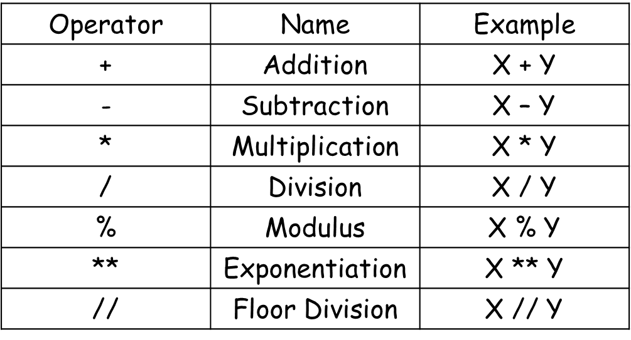
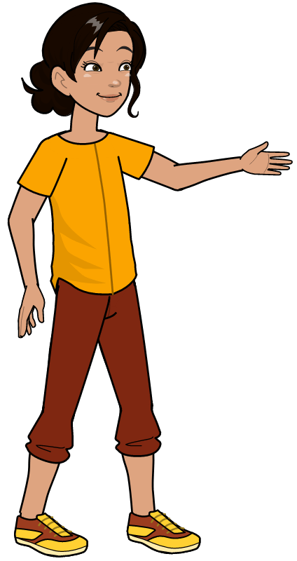
Arithmetic operators in python
Computer Science Department, UET Lahore.

Slide 15
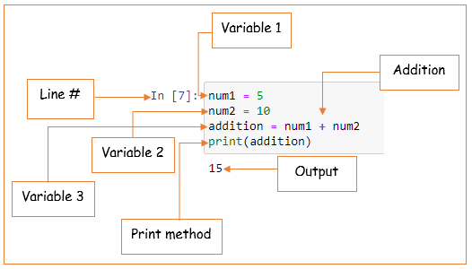
Arithmetic operators examples
Addition:
Computer Science Department, UET Lahore.

Slide 16
Activity
Try to use other arithmetic operations given in the table.
Computer Science Department, UET Lahore.

Slide 17
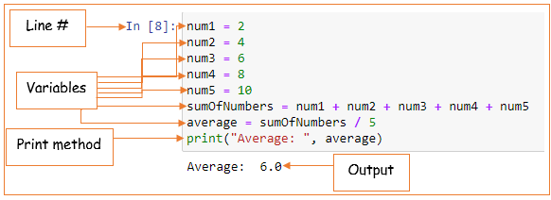
Mean calculation example
Mean: Program to calculate the average of first five even numbers.
Computer Science Department, UET Lahore.

Slide 18
Strings in python
Strings in python are surrounded by either single quotation marks, or double quotation marks.
'hello' is the same as "hello".
Computer Science Department, UET Lahore.

Slide 19
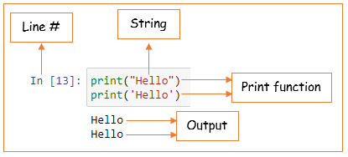
Strings in python
You can display a string literal with the print method:
Computer Science Department, UET Lahore.

Slide 20
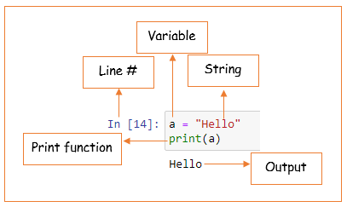
Assigning string to a variable in python
Assigning a string to a variable is done with the variable name followed by an equal sign (=) and the string:
Computer Science Department, UET Lahore.

Slide 21
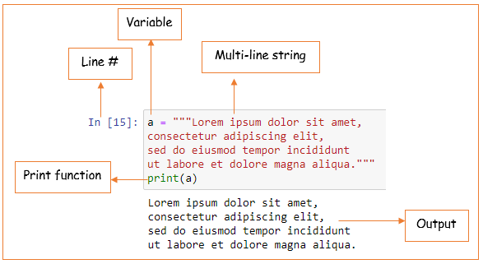
Multi-line strings in python
You can assign a multiline string to a variable by using three quotes:
Computer Science Department, UET Lahore.

Slide 22
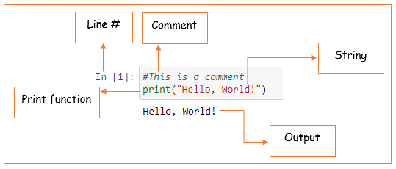
Comments in python
Comments starts with a #, and python will ignore them:
Computer Science Department, UET Lahore.

Slide 23

Learning Objective
In this lecture, we learnt about variables, assignment statements, arithmetic operators, print function, introduction to strings and getting input from user.
Computer Science Department, UET Lahore.

Slide 24
Conclusion
We wrote our first python program.
We learned about variables and their use in programming
To program computers to do something, we use programming language.
Python is a high-level programming language that is used to program computer to perform different tasks.
Computer Science Department, UET Lahore.

